Slide 1
SPCD fMRI results interim summary
Qingfang Liu
June 11, 2026

Slide 2
Behavioral results suggest that preconditioned cues carry reward identity. We ask:
where this identity is represented in the brain
whether it overlaps with conditioned-cue representations
Analysis: pre-meal RSA using odor-predictive cues only, excluding clean-air cues.
Neural RDM ~ odor identity RDM + button RDMs
Image-wise beta estimates were derived from the probe task in the pre-meal and post-meal sessions using LSS.
The neural RDM was then regressed onto odor-group and button-response model RDMs.
This is conducted for conditioned cues and preconditioned cues, separately.

Slide 3
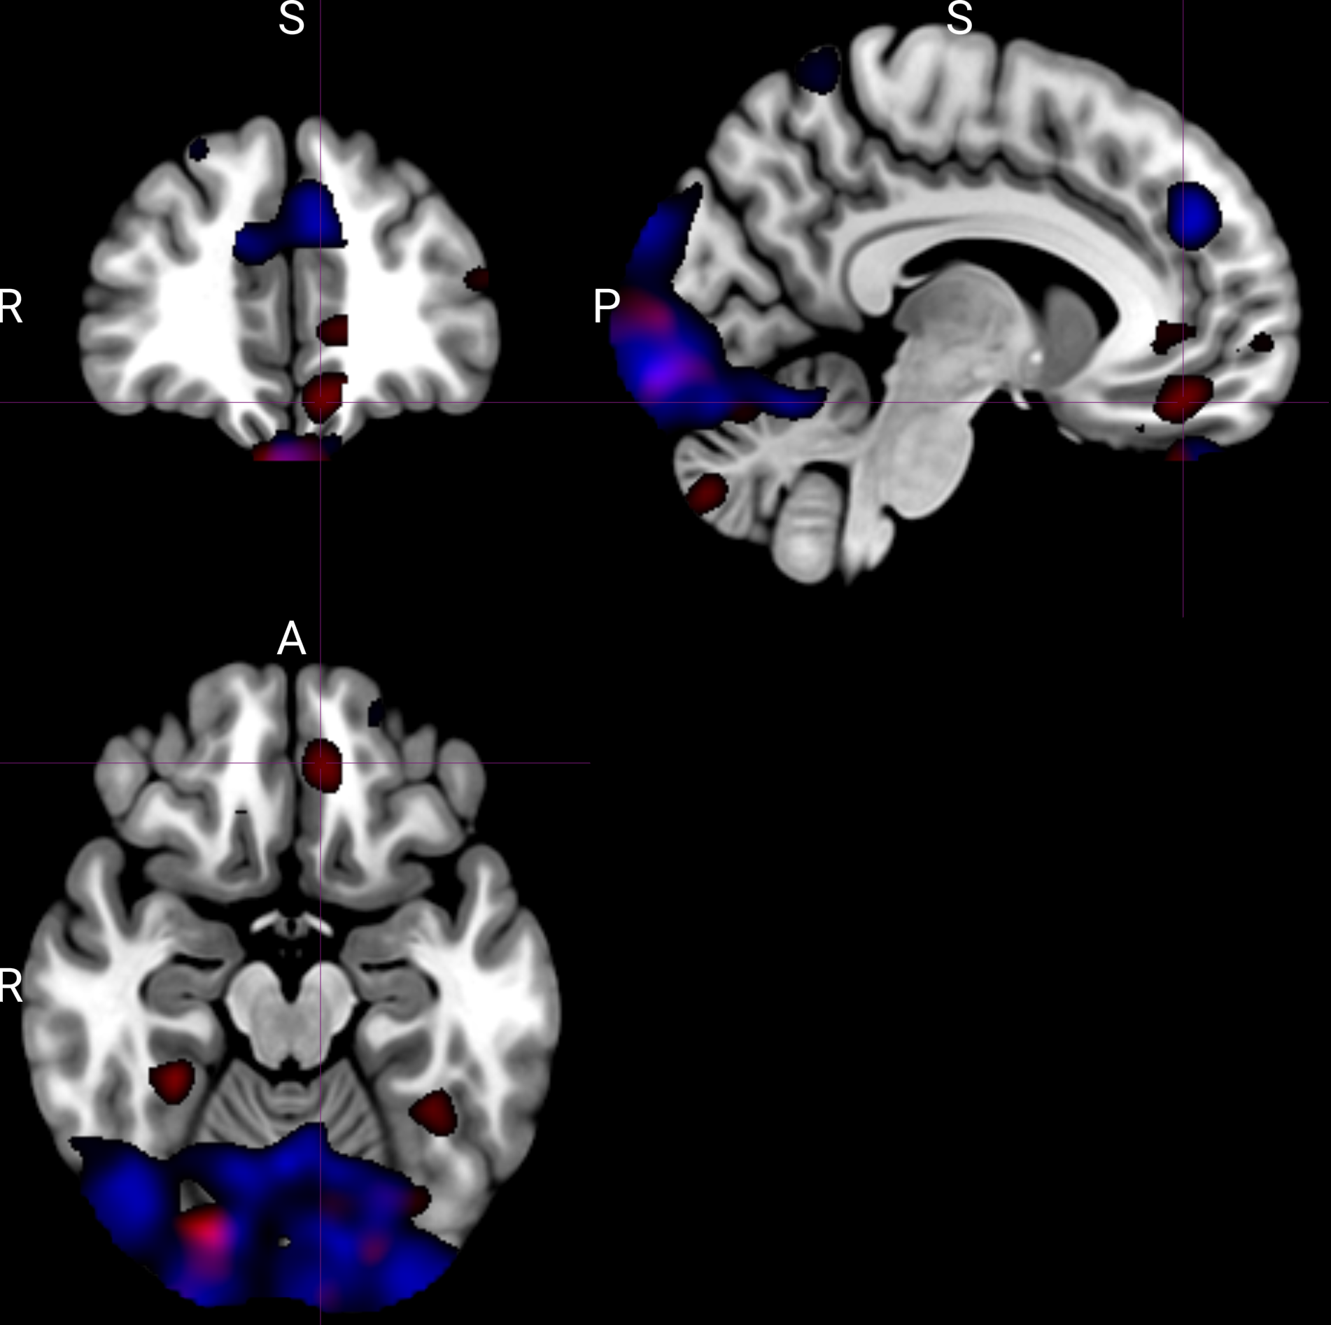
Whole-brain RSA identified candidate regions encoding expected reward identity.
Red: conditioned cues
Blue: preconditioned cues
Notes:
Without having image identity RDM regressor
Thresholded at >2

Slide 4
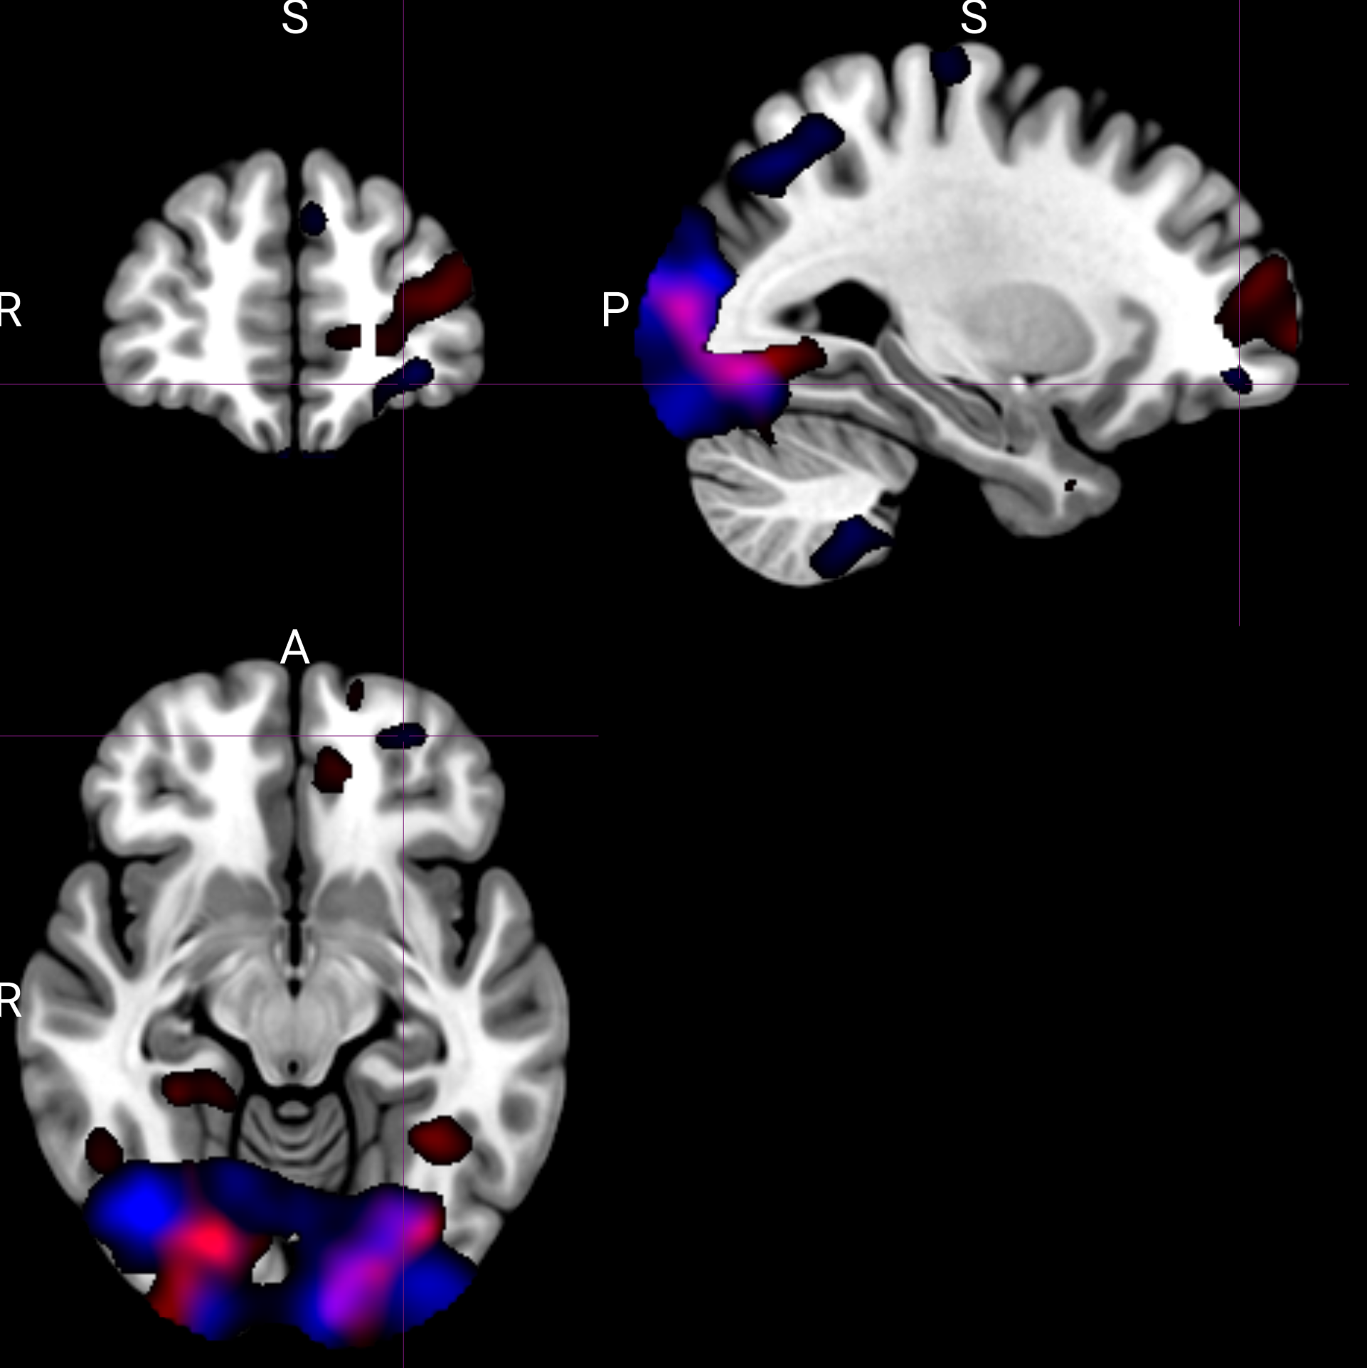
Conditioned and preconditioned cues showed partially distinct spatial patterns of reward-identity encoding.
Red: conditioned cues. Blue: preconditioned cues.

Slide 5
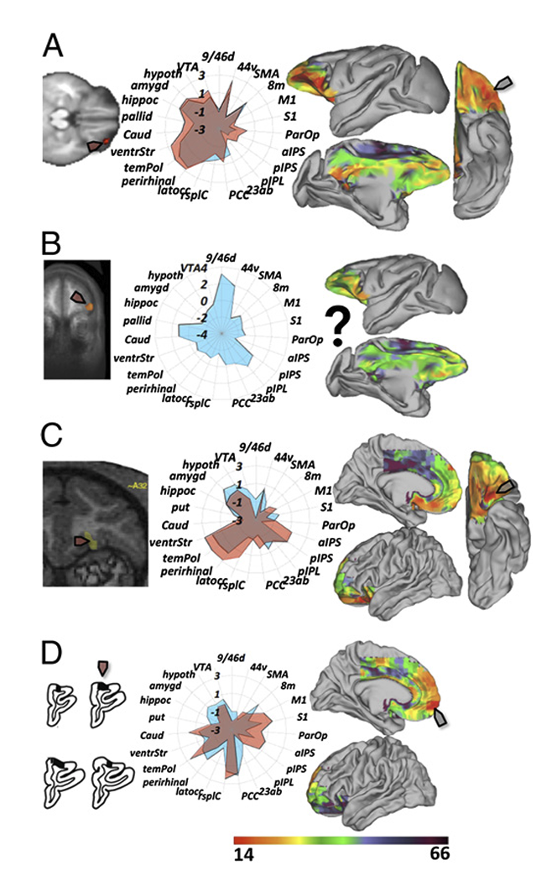
ROI-based analysis on reward identity representation
ROI analysis focused on OFC parcels from the Neubert 2015 parcellation.
Conditioned cues showed a trend in Left 14m, t(31) = 1.99, p = 0.055.
Preconditioned cues showed an effect in Right 11m, t(31) = 2.16, p = 0.038.

Slide 6
Neural RDM ~ odor identity RDM + cue type RDM + image identity RDM + button RDMs

Slide 7
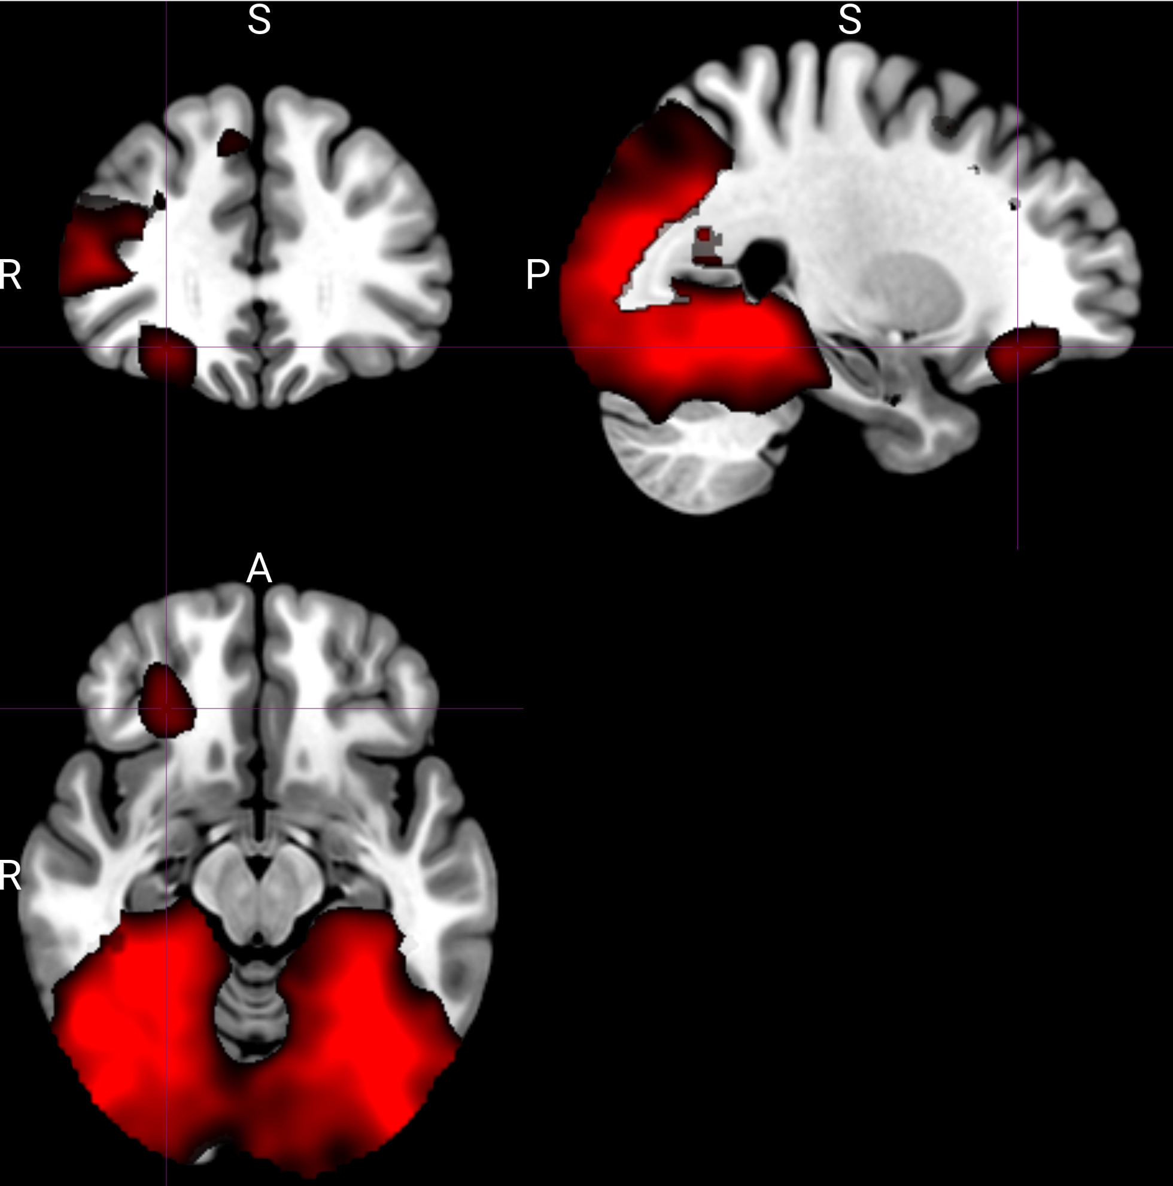
Different representation of cue-type (conditioned vs. preconditioned) identified from RSA
Data from across pre-meal and post-meal
Notes:
Thresholded at >3

Slide 8
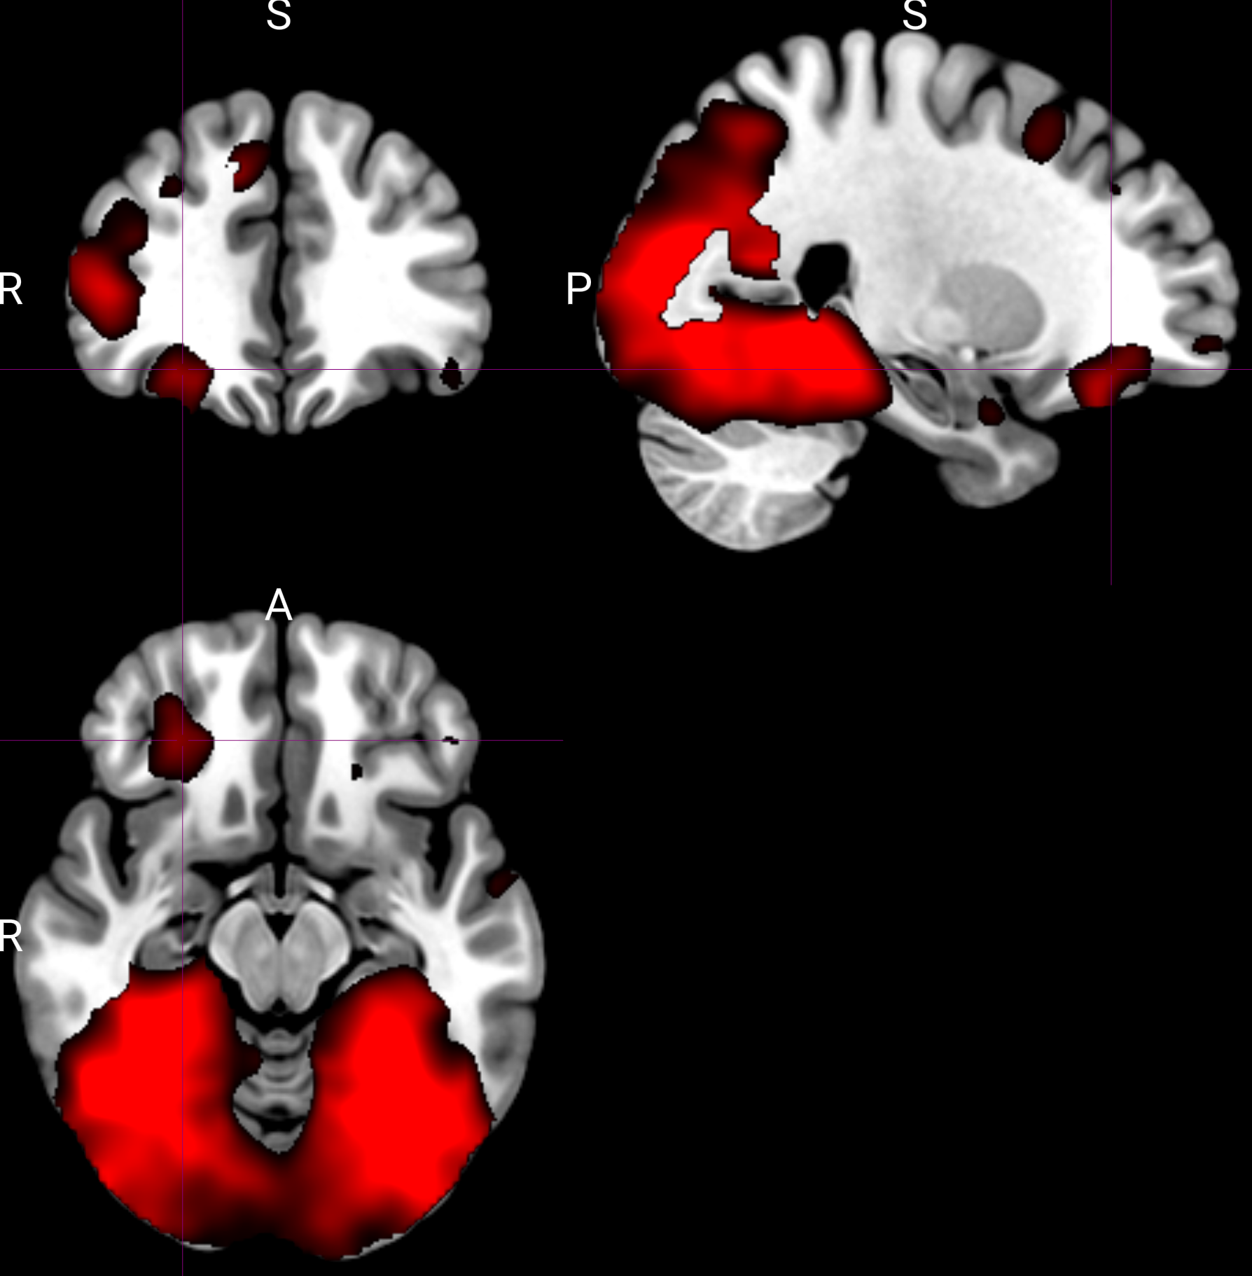
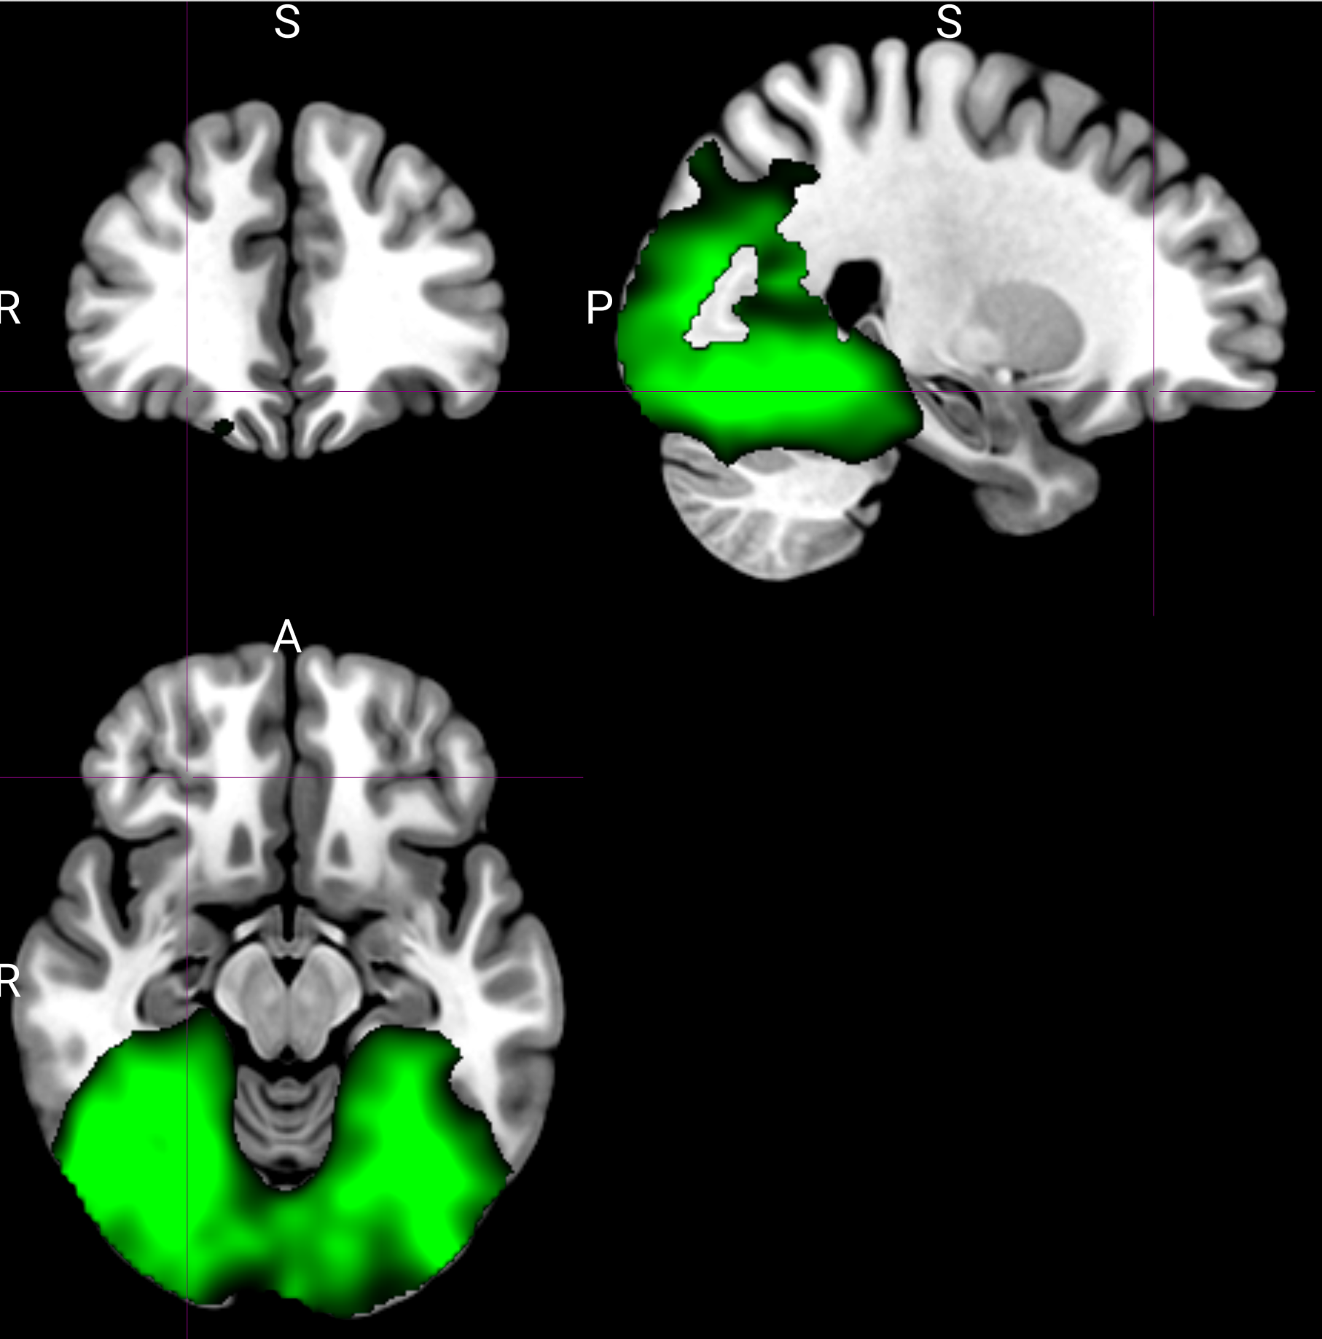
Comparing cue-type representation pre-meal (red) and post-meal (green)
Thresholded at >3 (26, 36, -14)

Slide 9
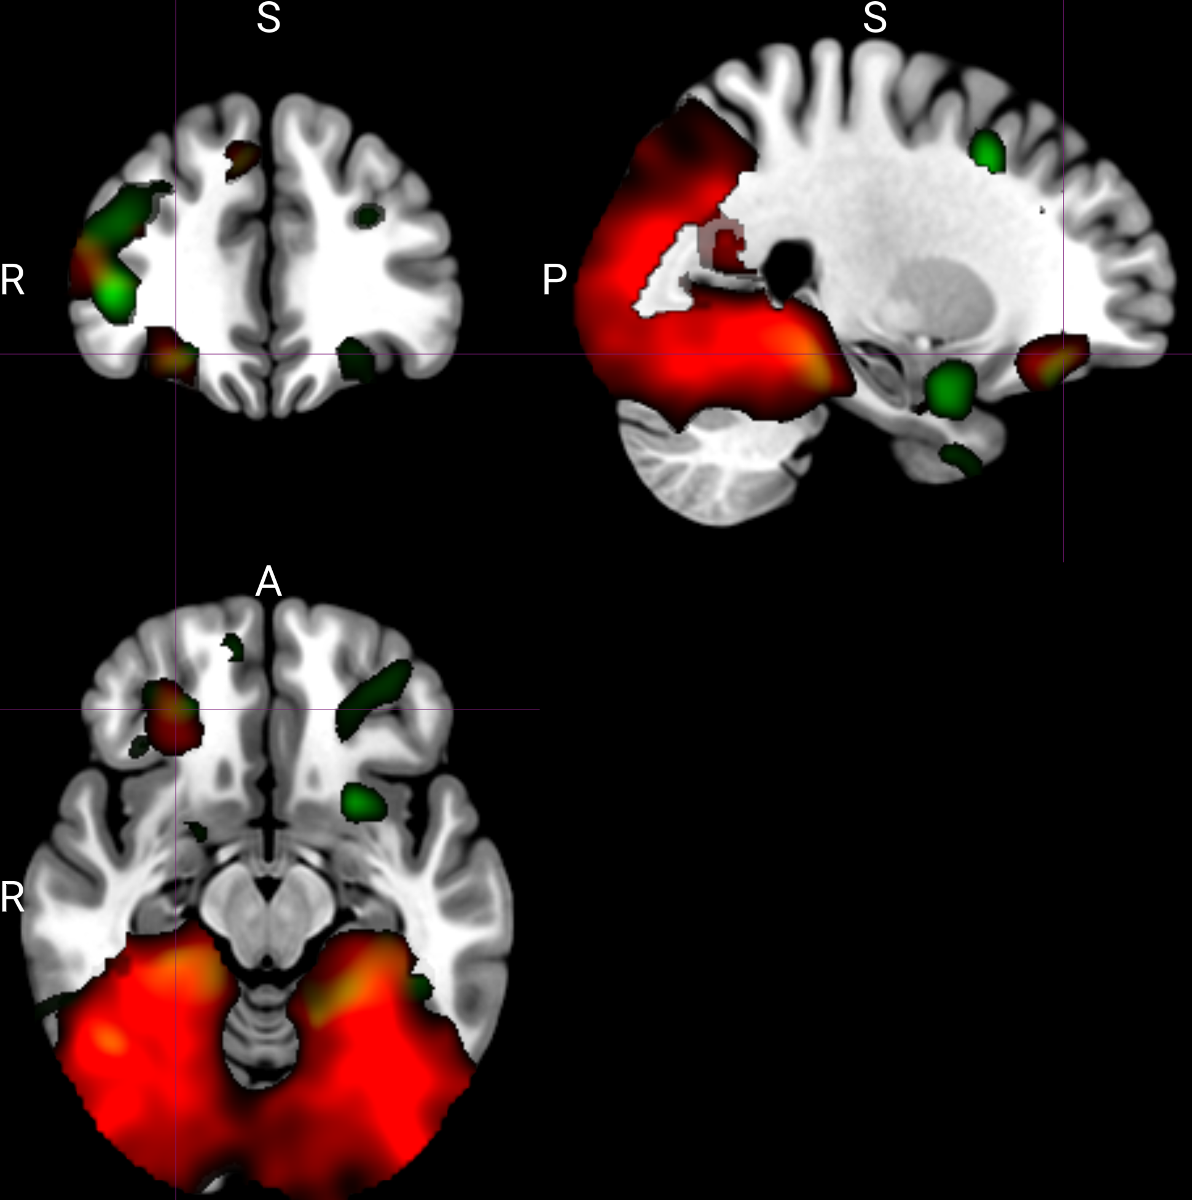
Cue-type representations decreased from pre- to post-meal.
Green shows the pre-to-post decrease, thresholded at t > 2 and overlaid on the cue-type map in red.

Slide 10
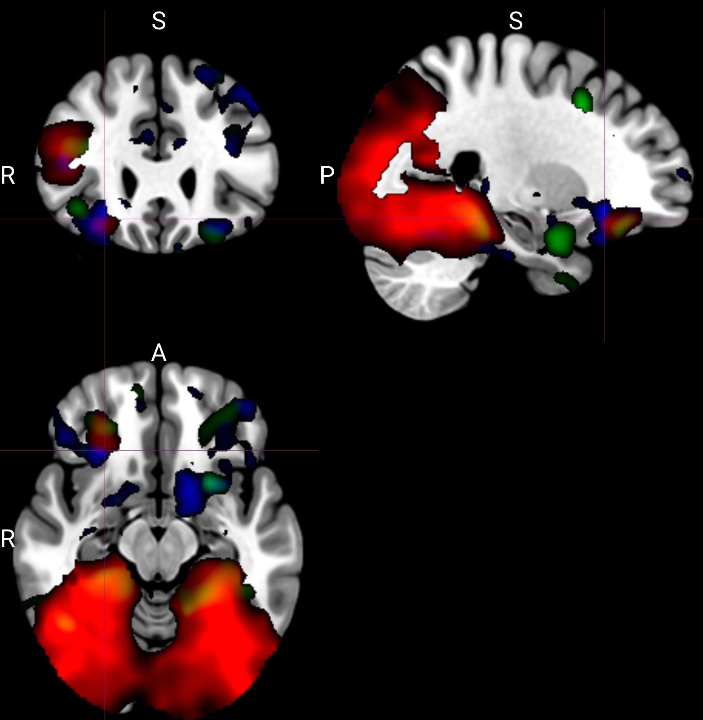
Univariate analysis showed stronger responses to preconditioned than conditioned cues in several regions.
Blue clusters are thresholded at t > 2.

Slide 11
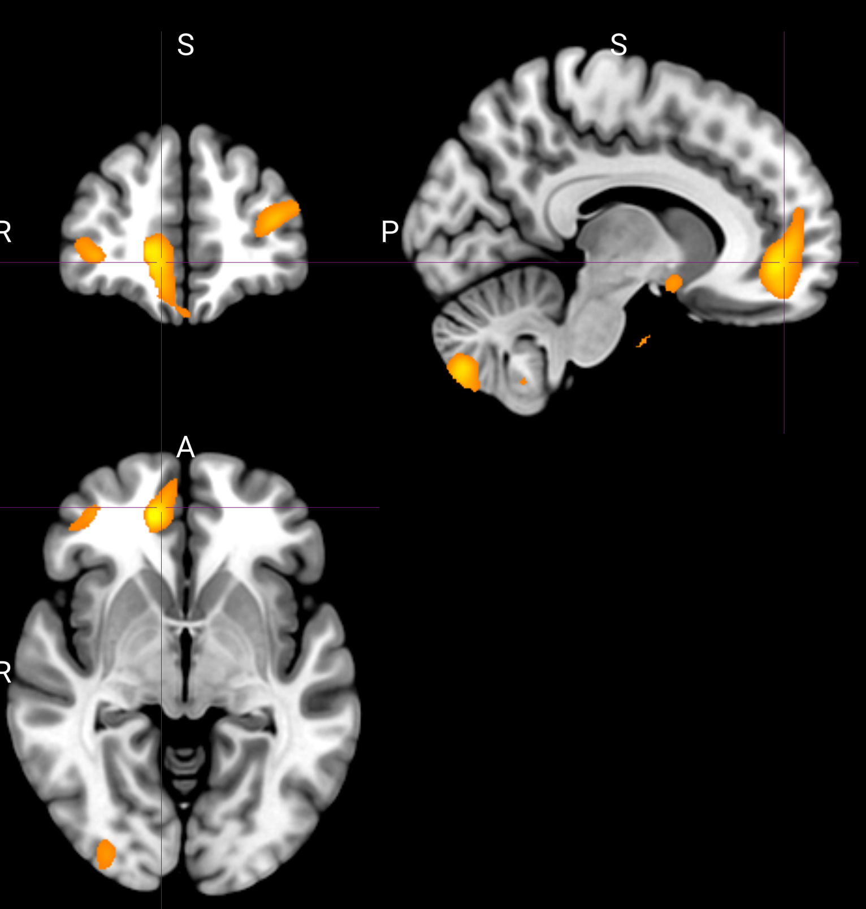
Value representation
Linked odor pleasantness ratings as a proxy for value
Use data across pre and post meals

